Slide 1
System Stability: Routh Hurwitz, Root Locus and
Nyquist Criterion- Lecture 5
Instructor: Sanghyuk Lee
Sanghyuk.Lee@xjtlu.edu.cn
Tel: 8816-1415
Department of Electrical and Electronic Engineering
XJTLU

Slide 2
Contents
Routh Hurwitz
Root Locus
Nyquist Criterion

Slide 3
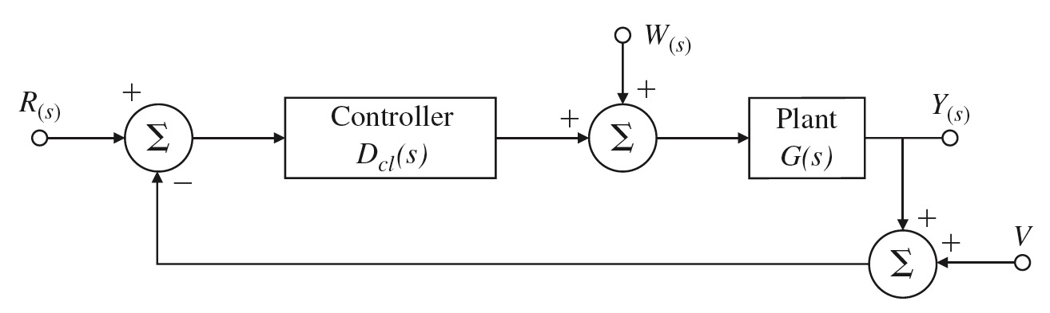
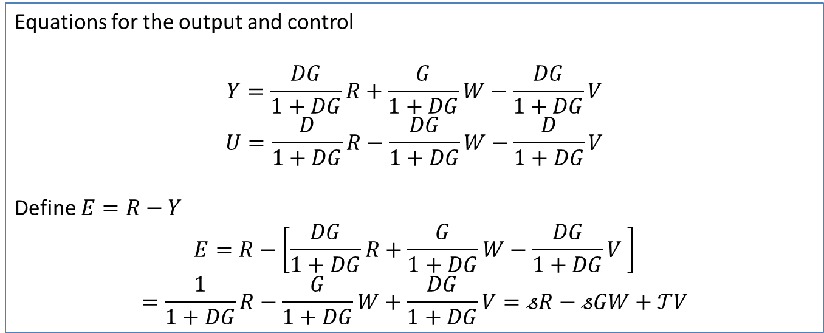
Steady state tracking and system type
Consider block diagram

Slide 4
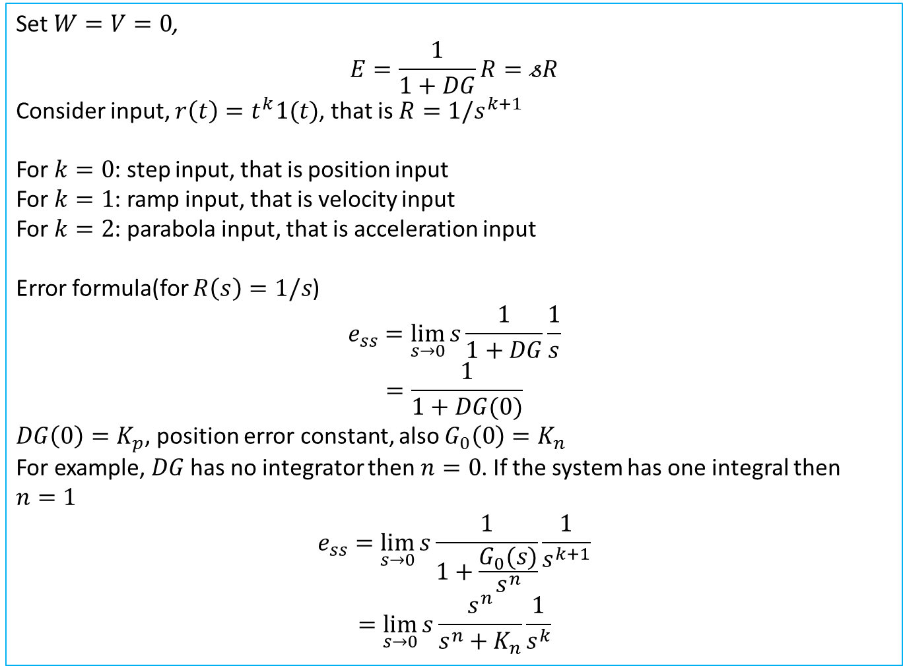
Steady state tracking and system type

Slide 5
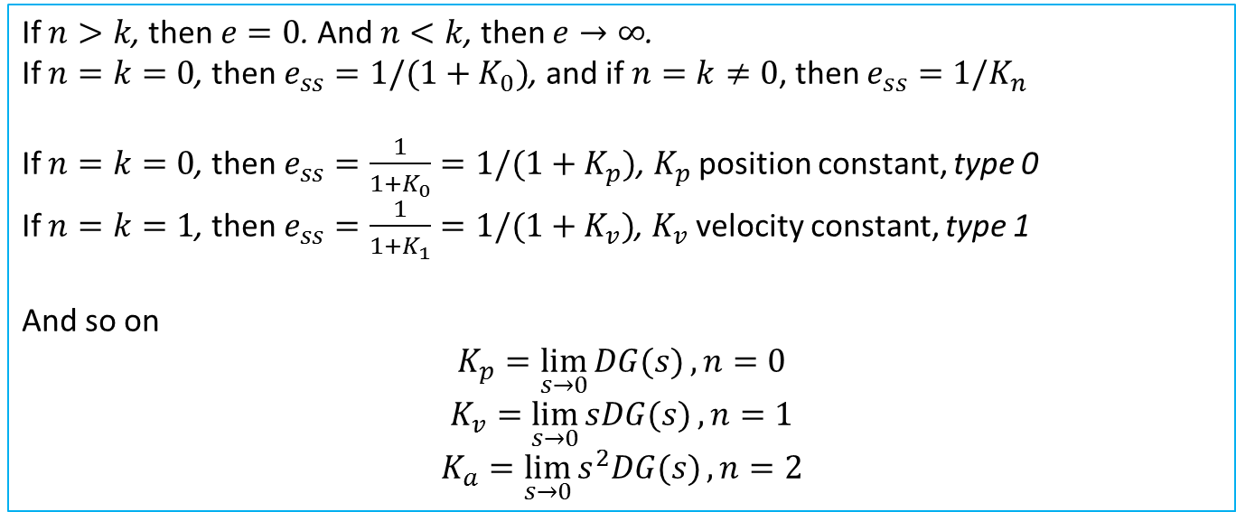
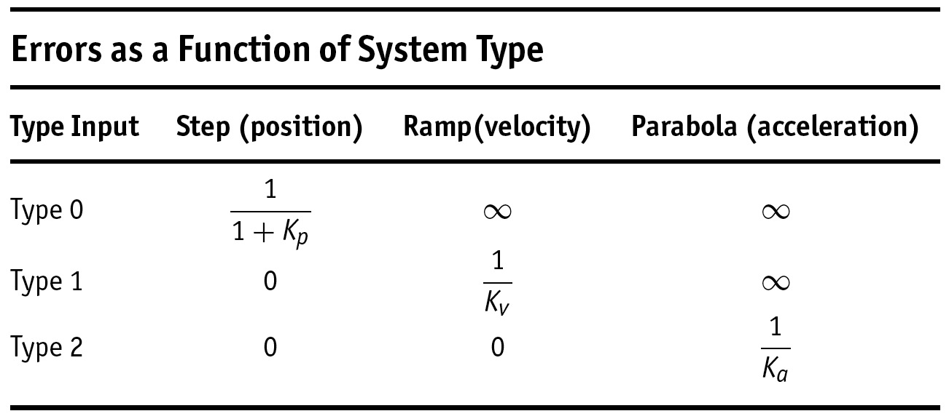
System Type

Slide 6

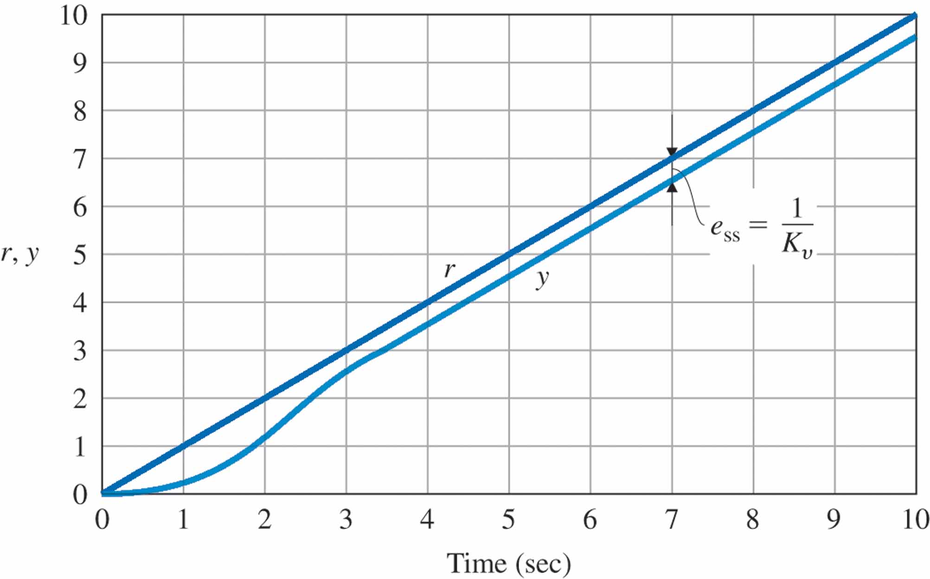
Digital Control and Automatic Control EEE327

Slide 7
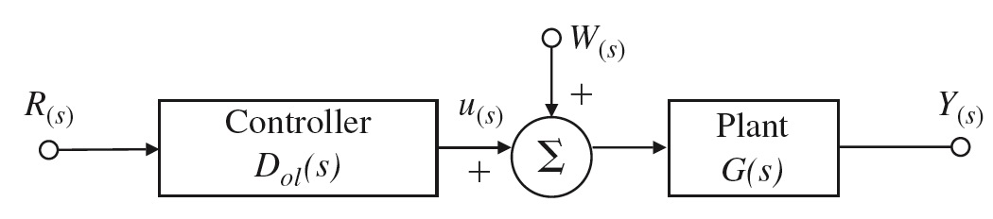
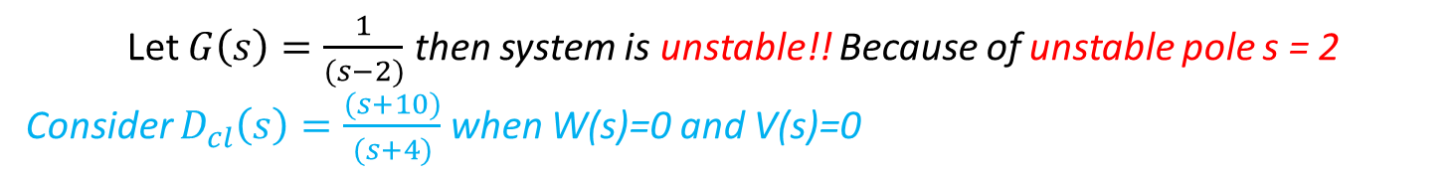
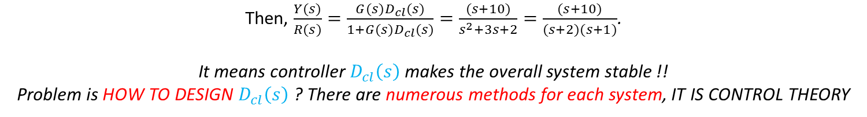
Example
Digital Control and Automatic Control EEE327
R(s)
Let $G\left(s\right)=\frac{1}{(s−2)}$ then system is unstable!! Because of unstable pole s = 2
Consider $D_{cl}\left(s\right)=\frac{(s+10)}{(s+4)}$ when W(s)=0 and V(s)=0
Then, $\frac{Y(s)}{R(s)}=\frac{G(s)D_{cl}(s)}{1+G(s)D_{cl}(s)}=\frac{(s+10)}{s^{2}+3s+2}=\frac{(s+10)}{(s+2)(s+1)}$.
It means controller $D_{cl}\left(s\right)$ makes the overall system stable !!
Problem is HOW TO DESIGN $D_{cl}\left(s\right)$ ? There are numerous methods for each system, IT IS CONTROL THEORY

Slide 8
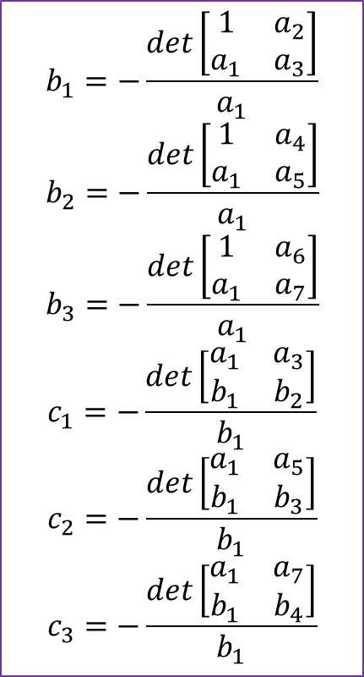
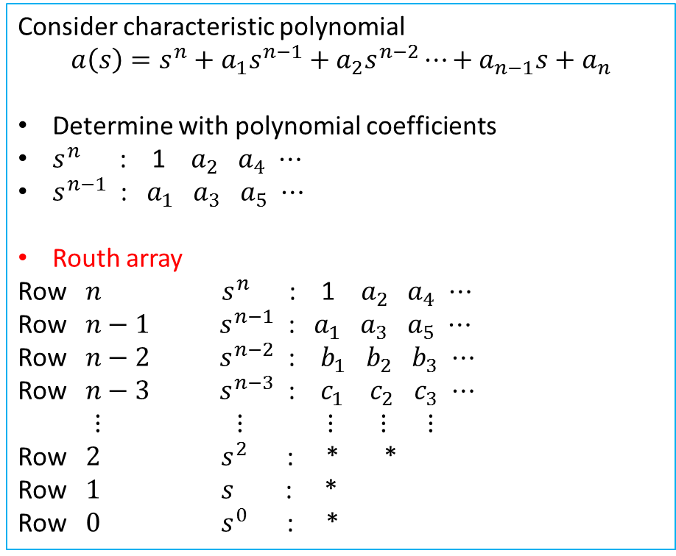
Stability
One of the most important consideration to design controller
Stability determination is verified by pole location
Routh’s Criterion
Consider characteristic polynomial
$$a\left(s\right)=s^{n}+a_{1}s^{n−1}+a_{2}s^{n−2}⋯+a_{n−1}s+a_{n}$$
Determine with polynomial coefficients
$s^{n}$ : 1 $a_{2}$ $a_{4}$ $⋯$
$s^{n−1}$ : $a_{1}$ $a_{3}$ $a_{5}$ $⋯$
Routh array
Row $n$ $s^{n}$ : 1 $a_{2}$ $a_{4}$ $⋯$
Row $n−1$ $s^{n−1}$ : $a_{1}$ $a_{3}$ $a_{5}$ $⋯$
Row $n−2$ $s^{n−2}$ : $b_{1}$ $b_{2}$ $b_{3}$ $⋯$
Row $n−3$ $s^{n−3}$ : $c_{1}$ $c_{2}$ $c_{3}$ $⋯$
$⋮$ $⋮$ $⋮$ $⋮$ $⋮$
Row $2$ $s^{2}$ : * *
Row $1$ $s$ : *
Row $0$ $s^{0}$ : *
$$b_{1}=−\frac{det\left[\begin{matrix}1 & a_{2} \\ a_{1} & a_{3}\end{matrix}\right]}{a_{1}}$$
$$b_{2}=−\frac{det\left[\begin{matrix}1 & a_{4} \\ a_{1} & a_{5}\end{matrix}\right]}{a_{1}}$$
$$b_{3}=−\frac{det\left[\begin{matrix}1 & a_{6} \\ a_{1} & a_{7}\end{matrix}\right]}{a_{1}}$$
$$c_{1}=−\frac{det\left[\begin{matrix}a_{1} & a_{3} \\ b_{1} & b_{2}\end{matrix}\right]}{b_{1}}$$
$$c_{2}=−\frac{det\left[\begin{matrix}a_{1} & a_{5} \\ b_{1} & b_{3}\end{matrix}\right]}{b_{1}}$$
$$c_{3}=−\frac{det\left[\begin{matrix}a_{1} & a_{7} \\ b_{1} & b_{4}\end{matrix}\right]}{b_{1}}$$
Number of sign change in first column represent number of roots in RHP. All 1st col. positive ➔ All roots in LHP

Slide 9
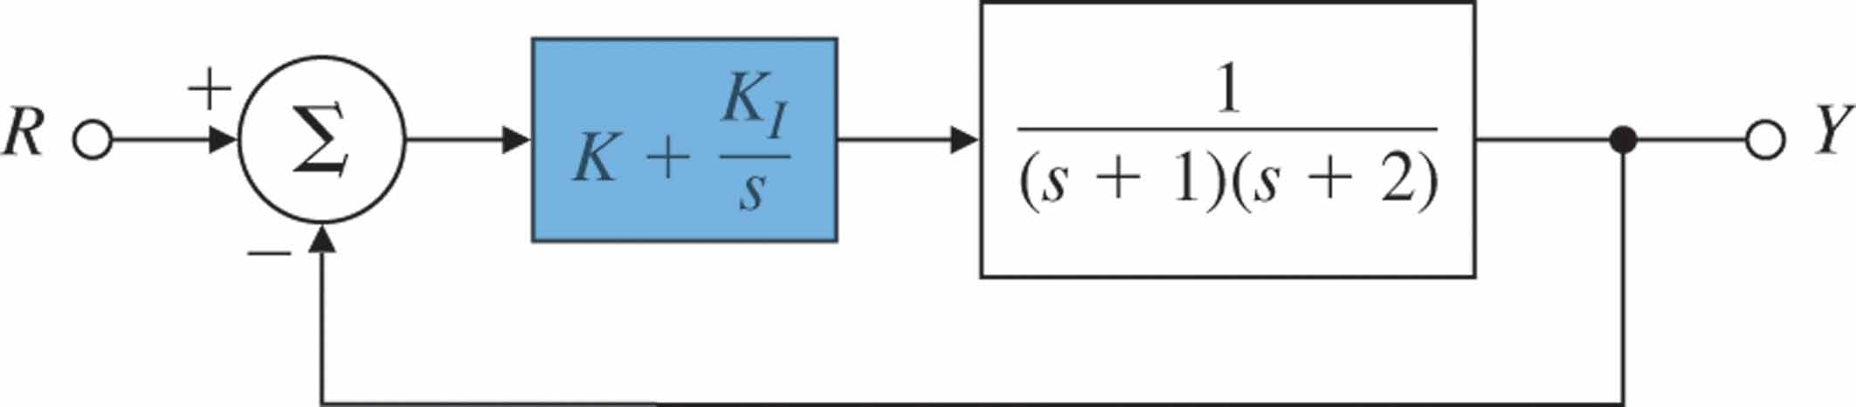
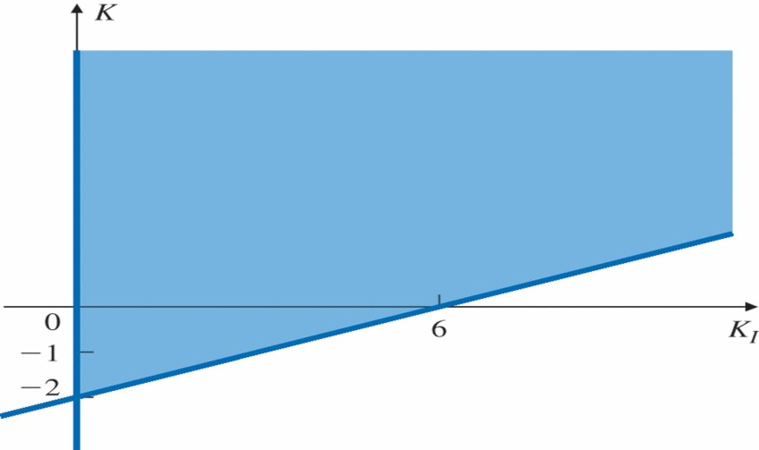
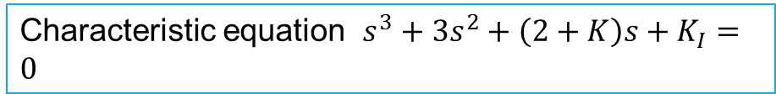
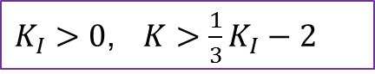
Examples
Digital Control and Automatic Control EEE327
Find range of the controller (${K, K}_{I}$) so that feedback system is stable
Critical cases
Characteristic equation $s^{3}+3s^{2}+\left(2+K\right)s+K_{I}=0$
$K_{I}>0$, $K>\frac{1}{3}K_{I}−2$
Allowable region for stability

Slide 10
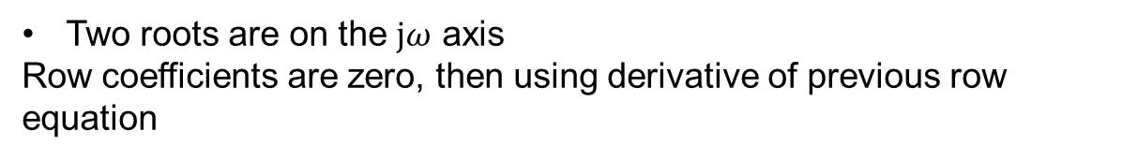
Digital Control and Automatic Control EEE327
Examples
Characteristic equation $s^{5}$+3$s^{4}$+ 2$s^{3}+6s^{2}+6s+9=0$
Two roots are not in LHP
Denominator zero replace to dummy variable
Characteristic equation $s^{5}$+5$s^{4}$+ 11$s^{3}+23s^{2}+28s+12=0$
Two roots are on the $jω$ axis
Row coefficients are zero, then using derivative of previous row equation
Discussion :
What is strong point of Routh’ criterion ?
What is week point of Routh’ criterion ?

Slide 11
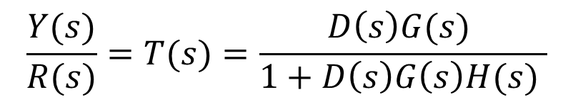
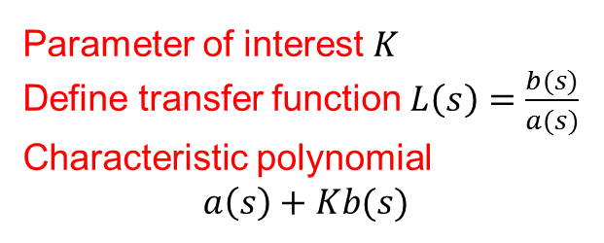
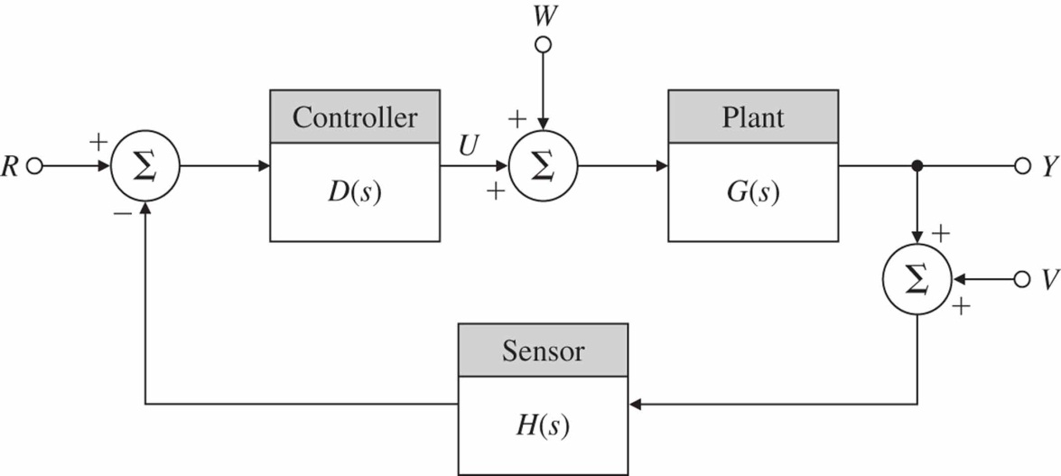
Digital Control and Automatic Control EEE327
Root-Locus Design Method
Closed loop transfer function
Characteristic equation
Basic closed-loop block diagram

Slide 12

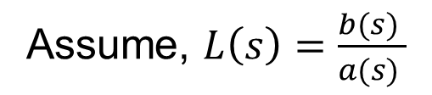
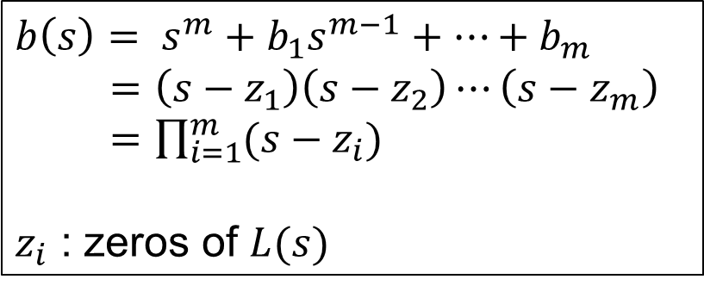
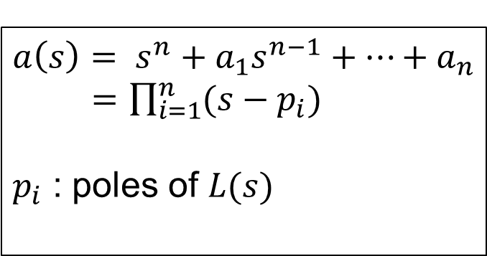
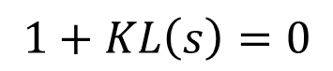
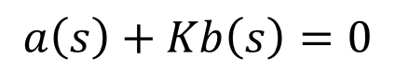
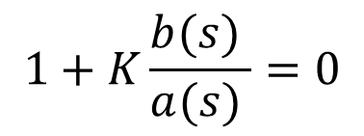
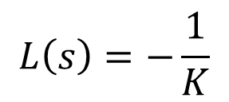
Definition of Root-Locus
Factor the polynomial as
Equivalent root locus expressions
Root locus form
Evans form of a characteristic equation

Slide 13
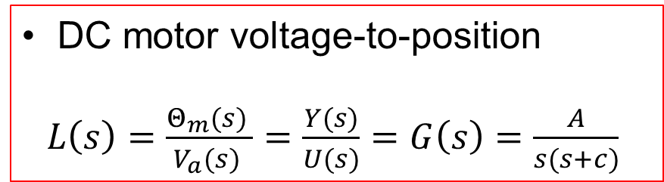
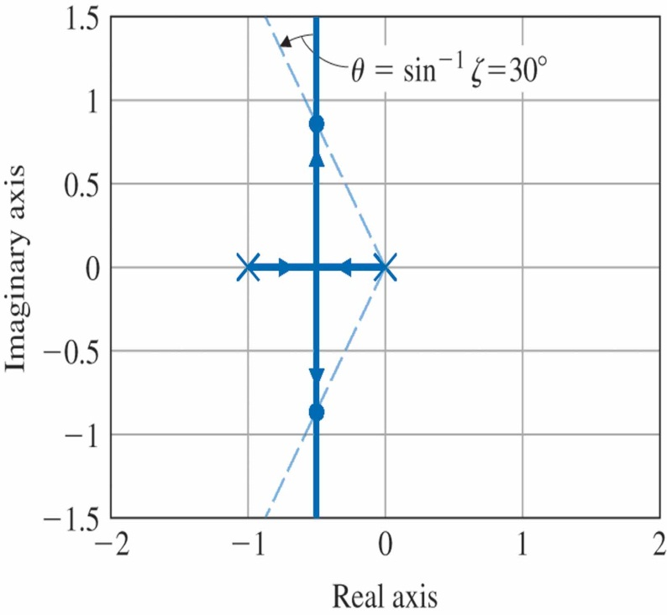
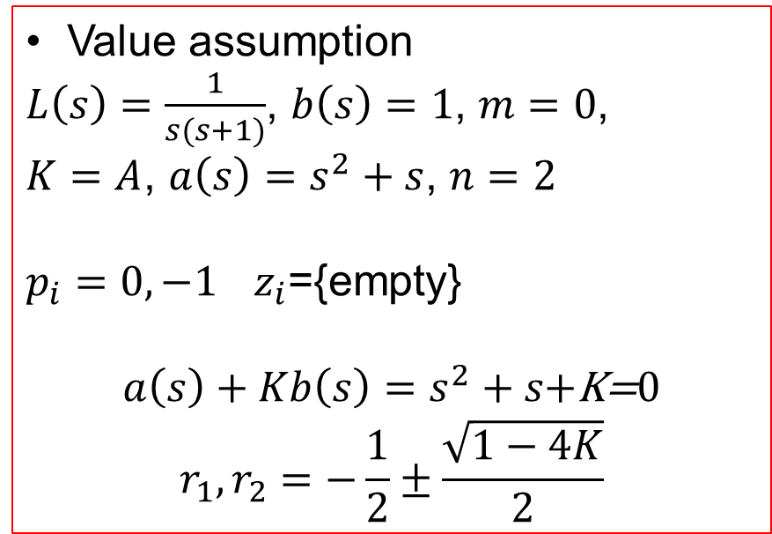
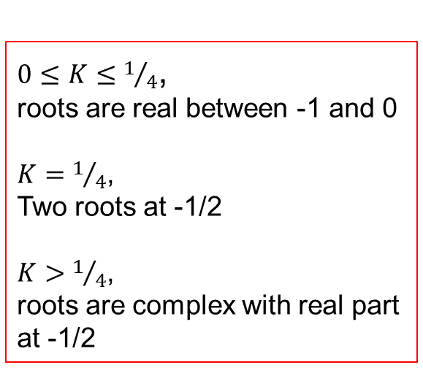
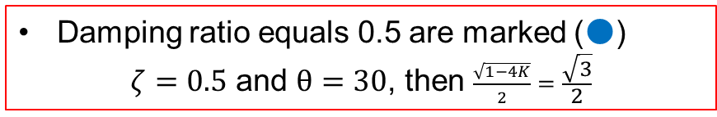
Root locus for

Slide 14
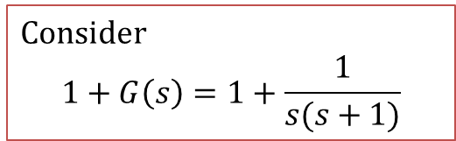
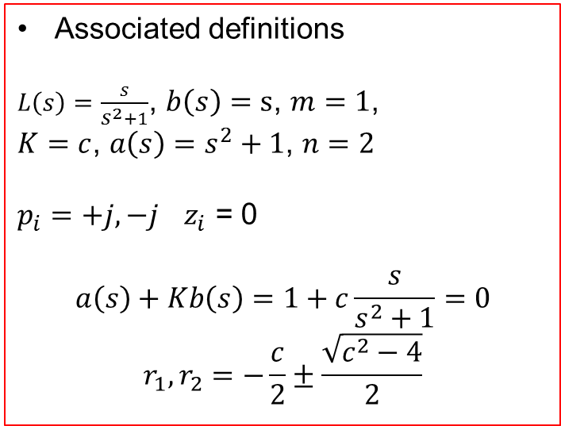
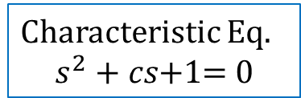
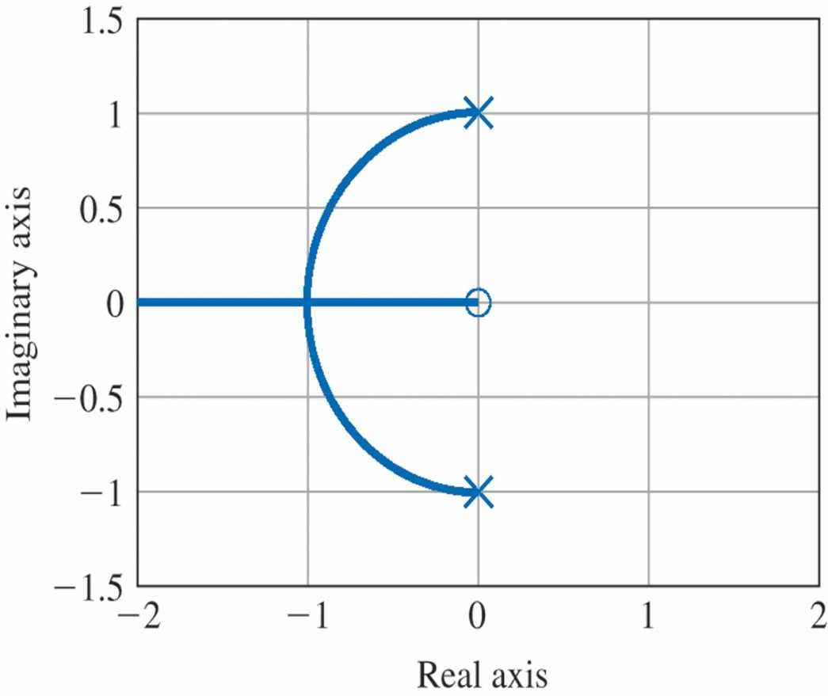
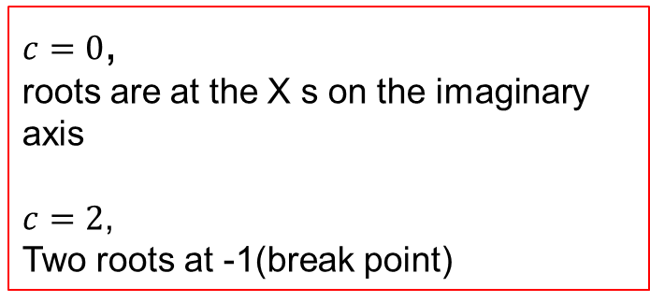
Root locus vs. damping factor c for 1 + G(s) =

Slide 15
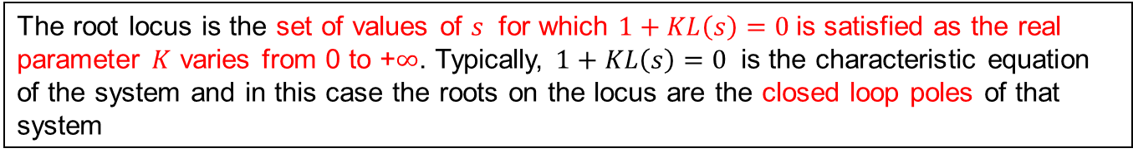
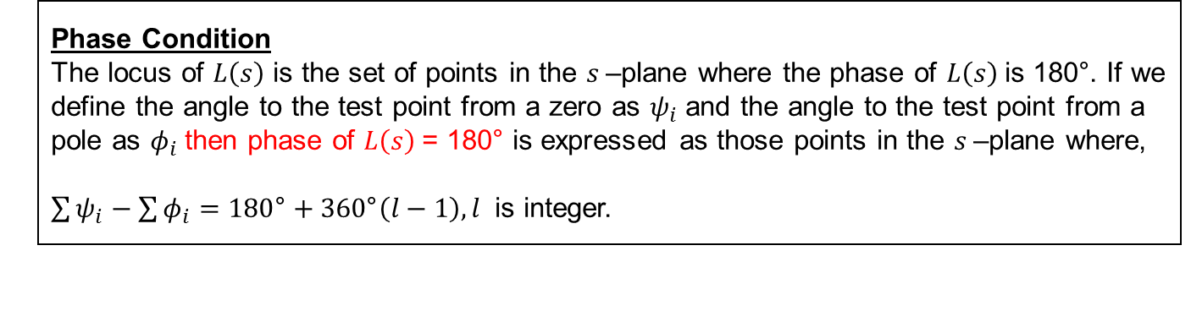
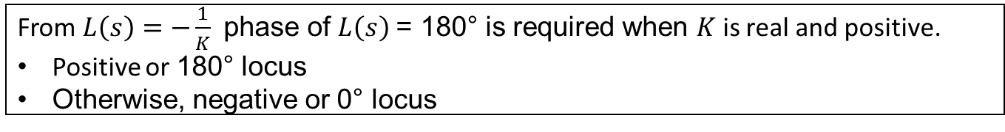
Guidelines for Sketching a Root locus
It has the meaning that closed loop pole observation is possible by the variation of control value (K)

Slide 16

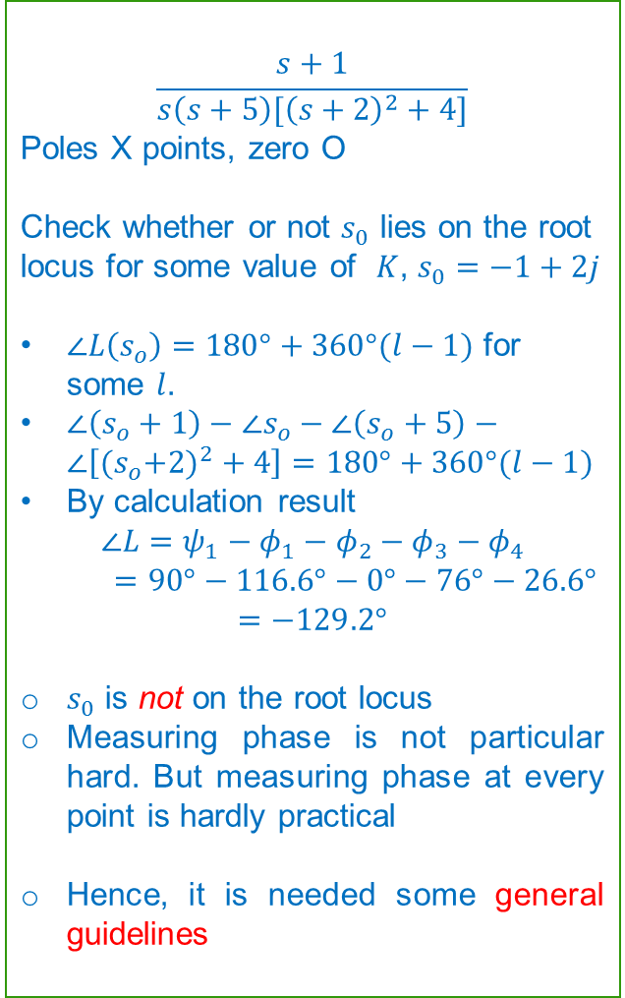
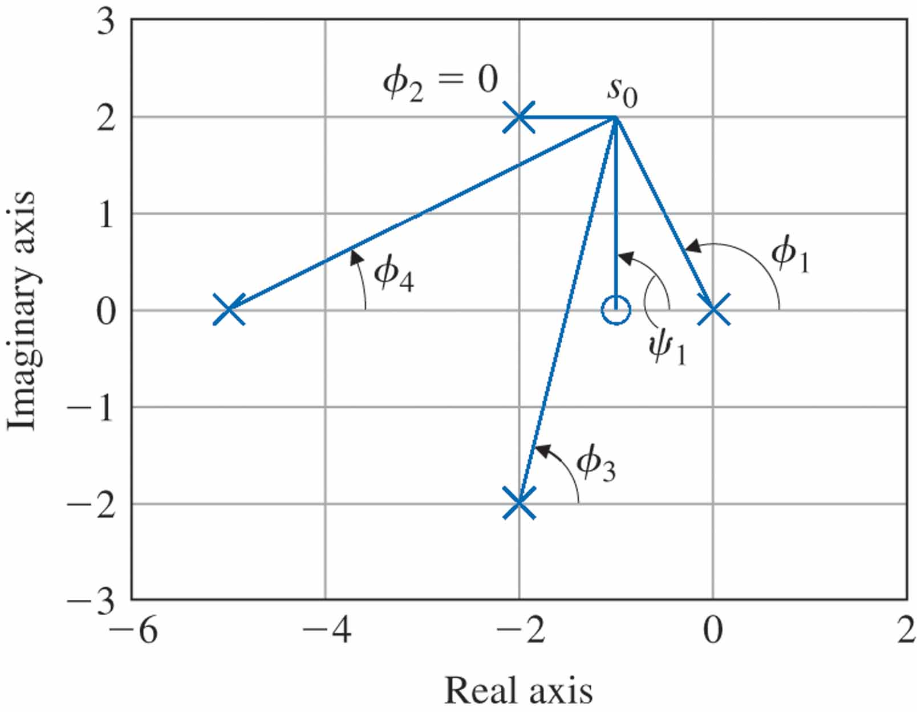
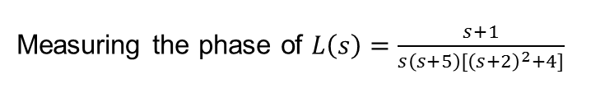

Slide 17
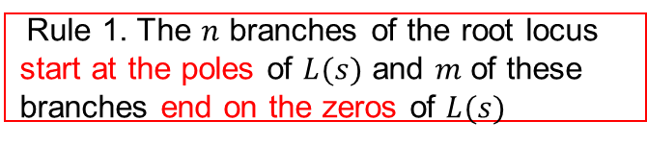
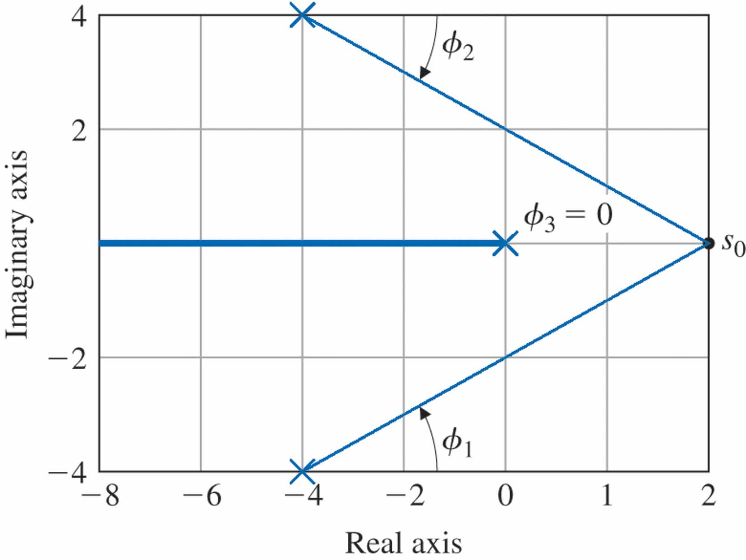
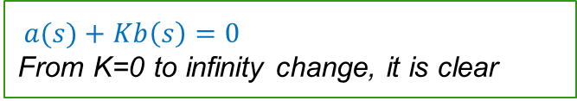
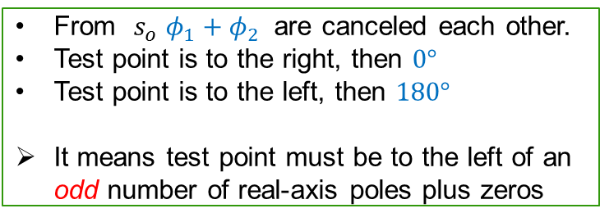
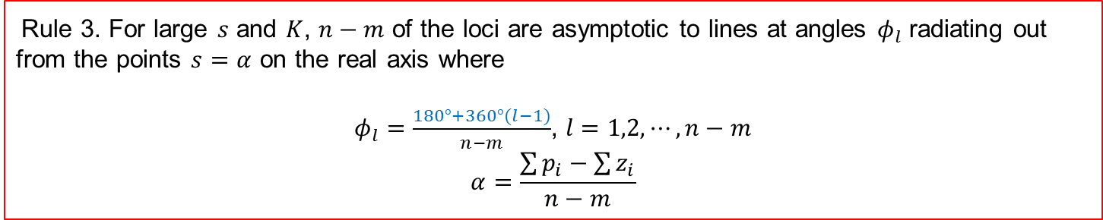
Rule 2. The loci are on the real axis to the left of an odd number of poles and zeros

Slide 18
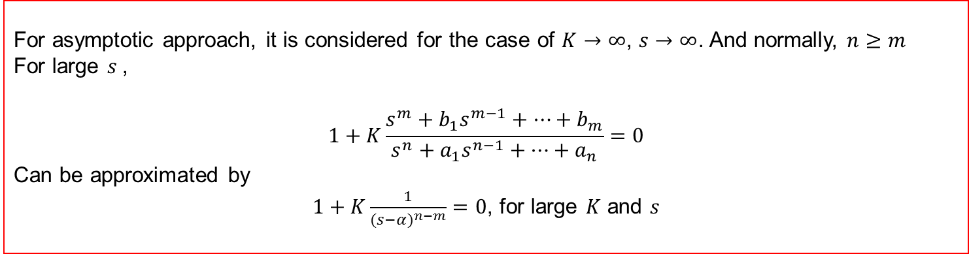
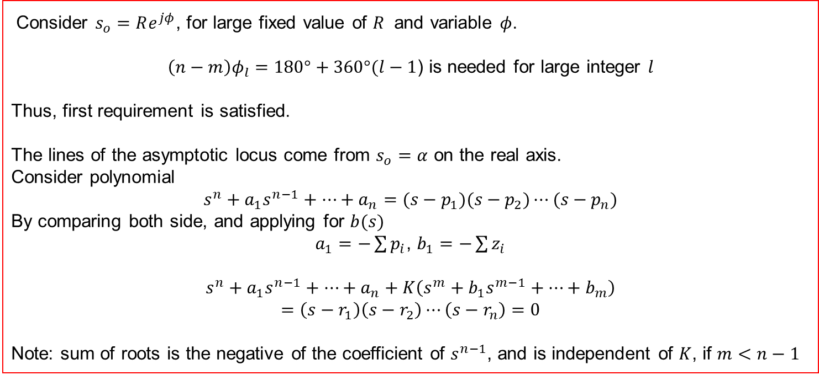

Slide 19
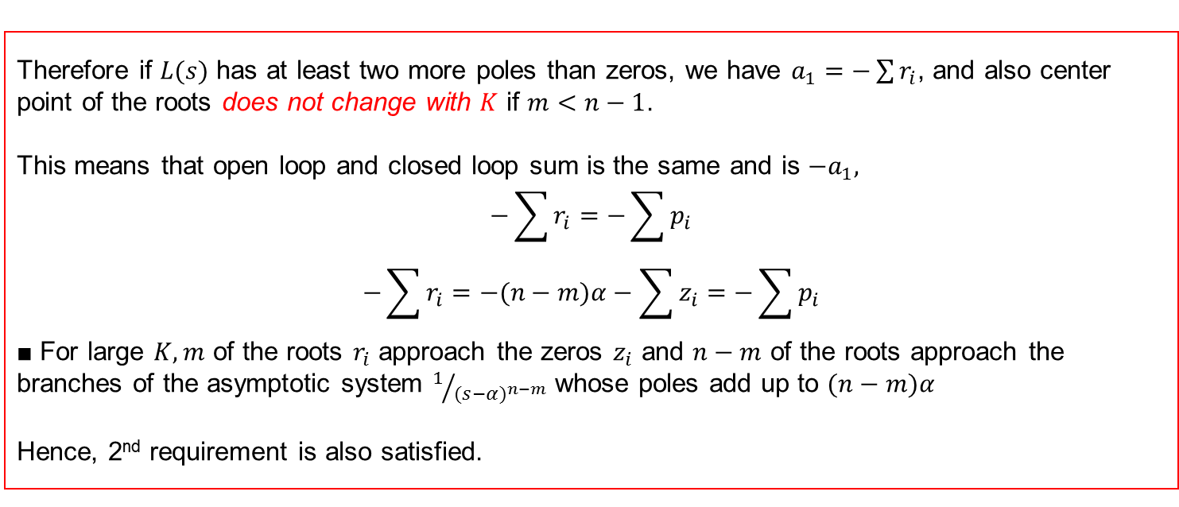


Slide 20



The asymptotes are n − m radial lines from α at equal angles
The departure and arrival angles are found by looking near a pole or zero

Slide 21




Slide 22




Slide 23





Slide 24




Slide 25




Root locus of the Satellite Control with a Collocated Flexibility

Slide 26



Conclusions :
Third pole is near the zero, there is only a modest distortion of the locus
Additional pole moving in from the far left tends to push the locus branches to the right as it approaches a given locus
What about pole at -1 and infinity ?
Added pole at -4 -9 -12

Slide 27
Preliminaries about Frequency Response
The Frequency of a system is defined as the steady-state response of the system to a sinusoidal input signal. The sinusoid is a unique input signal, and the resulting output signal for a linear system, as well as signals throughout the system, is sinusoidal in the steady state; it differs from the input waveform only in amplitude and phase angle.
Consider $Y\left(s\right)=T\left(s\right)R\left(s\right)$ with $r\left(t\right)=A\sin{ωt}$
$R\left(s\right)=\frac{Aω}{s^{2}+ω^{2}}$, $T\left(s\right)=\frac{m(s)}{q(s)}=\frac{m(s)}{\prod_{i=1}^{n}{(s+p_{i})}}$
Then, we have
$Y\left(s\right)=\frac{k_{1}}{s+p_{1}}+⋯+\frac{k_{n}}{s+p_{n}}+\frac{αs+β}{s^{2}+ω^{2}}$
$y(t) =k_{1}e^{−p_{1}t}+⋯+k_{n}e^{−p_{n}t}+ℒ^{−1}\{\frac{αs+β}{s^{2}+ω^{2}}\}$
In the limit for $y(t)$, $y\left(t\right)=\frac{1}{ω}\left|AωT(jω)\right|\sin{(ωt+φ)}=A|T\left(jω\right)|\sin{(ωt+φ)}$

Slide 28




Preliminaries about Frequency Response
Advantage of Frequency response
Ready available sinusoidal signal test for various range
Easy to understand frequency behavior, $T\left(jω\right)$
Disadvantage of Frequency response
Not easy to link with time domain
Consider $RC$ filter
$G\left(s\right)=\frac{V_{2}(s)}{V_{1}(s)}=\frac{1}{RCs+1}$
Sinusoidal steady state transfer function
$G\left(jω\right)=\frac{1}{jω(RC)+1}=\frac{1}{j(ω/ω_{1})+1}$
Then, $G\left(jω\right)$ is represented by rectangular and magnitude and phase (polar).
$G\left(jω\right)=\frac{1}{1+{(\frac{ω}{ω_{1}})}^{2}}−\frac{j(\frac{ω}{ω_{1}})}{1+{(\frac{ω}{ω_{1}})}^{2}}$ and
$G\left(jω\right)=|G\left(jω\right)|∠φ(ω)$, $\left|G\left(jω\right)\right|=\frac{1}{{[\frac{1}{1+{(\frac{ω}{ω_{1}})}^{2}}]}^{1/2}}$ and $φ\left(ω\right)=−\tan^{−1}{(\frac{ω}{ω_{1}})}$

Slide 29



Examples of Polar plot
$$G\left(jω\right)=\frac{K}{jω(jωτ+1)}=\frac{K}{jω−ω^{2}τ}$$
Polar plot for
G(jω) = K/(jω(jωτ + 1)),
Note that ω = ∞ is at the origin
This plot can extend to Bode plot which include magnitude and Phase plot separately.

Slide 30


Transfer function

Slide 31

Transfer function

Slide 32


Nonminimum Phase and All pass function
Nonminimum Phase system, it has unstable zero
Same magnitude
Phase characteristic is different
Range of phase shift of minimun phase T.F is the least possible or minimum corresponding to a given amplitude curve.
Nonmimum case showed the greatest possible for the given amplitude curve.

Slide 33

All Pass function_ specific nonminimum phase

Slide 34

Mapping a square contour by F(s) = 2s + 1 = 2(s + 1/2)
Let $s=σ+jω$,
then define $F\left(s\right)=u+jv=2s+1=2\left(σ+jω\right)+1$
$u=2σ+1$ and $v=2ω$

Slide 35


Mapping a square contour by F(s) = s/(s+2)

Slide 36


$F\left(s\right)=2s+1$ and $F\left(s\right)=\frac{s}{s+2}$
The contour in the $F(s)$ plane encircles the origin once, because
$$N=Z−P=1$$
Cauchy’ theorem(Principle of the Argument)
If a contour $Γ_{s}$ in the s-plane encircles $Z$ zeros and $P$ poles of $F(s)$ and does not pass through any poles or zeros of $F(s)$ and the traversal is in the clockwise direction along the contour, the corresponding contour $Γ_{F}$ in the $F(s)$ plane encircles the origin of the $F(s)$ plane $N=Z−P$ times in the clockwise direction.

Slide 37

For $F\left(s\right)=\frac{s}{s+1/2}$, unit square contour results $N=Z−P=0$

Slide 38



For $F\left(s\right)=\frac{(s+z_{1})(s+z_{2})}{(s+p_{1})(s+p_{2})}$, $F\left(s\right)=\left|F\left(s\right)\right|∠F\left(s\right)$ $=\frac{\left|s+z_{1}\right||s+z_{2}|}{\left|s+p_{1}\right||s+p_{2}|}(∠s+z_{1}$ +$∠s+z_{2}$ $−∠s+p_{1}$ $−∠s+p_{2}$) $$=\left|F\left(s\right)\right|(φ_{z_{1}}+φ_{z_{2}}−φ_{p_{1}}−φ_{p_{2}})$$
Net angle change as s traverse along $Γ_{s}$(Full rotation of $360°$
For $φ_{z_{2}},φ_{p_{1}},φ_{p_{2}}$ ) is zero degree.
However, for $φ_{z_{1}}$ as s traverses $360°$ around $Γ_{s},$ the angle $φ_{z_{1}}$ traverses a full $360°$ clockwise.

Slide 39



Thus, as $Γ_{s}$ is completely traversed, the net angle increase of F(s) is equal to $360°$, since only one zero is enclosed. If $Z$ zeros were enclosed within $Γ_{s}$ , then the net angle increase would be equal to $φ_{z}=2πZ$ rad. If $Z zeros and P poles$ are encircled as $Γ_{s}$ is traversed, then $2πZ−2πP$ is the net resultant angle increase of F(s). Thus, the net angle increase of $Γ_{F}$ of the contour in the F(s) plane is simply $φ_{F}=φ_{z}−φ_{P}$ or $2πN=2πZ−2πP$
Net number of encirclements of the origin of the F(s) plane is
$$N=Z−P$$
Encircle one zero ➔ encircles the origin once in the clockwise direction

Slide 40

$$N=3−1=2$$

Slide 41

$$N=Z−P=−1$$

Slide 42


Stability check via Nyquist Criterion
Characteristic function $F\left(s\right)=1+L\left(s\right)=1+\frac{K\prod_{i=1}^{n}{(s+z_{i})}}{\prod_{k=1}^{M}{(s+p_{k})}}$
For stability, all the zeros of $F\left(s\right)$ should lie in the left half plane. Thus, we find that the roots of a stable system must lie to the left of the $jω$ axis in the s plane.
We choose a contour $Γ_{s}$in the s plane that encloses the entire right hand s plane, and determine whether any zeros of $F\left(s\right)$ lie within $Γ_{s}$ by utilizing Cauchy’s theorem.
Plot $Γ_{F}$ in the $F\left(s\right)$ plane and determine the number of encirclements of the origin $N$. Then the number of zeros of $F\left(s\right)$ within the $Γ_{s}$ contour is
$$Z=N+P$$
If $P=0$, number of unstable roots of the system = N, number of encirclements of the origin of the $F\left(s\right)$ plane

Slide 43



Stability check via Nyquist Criterion
Nyquist contour encloses the entire right half s-plane. The contour $Γ_{s}$ passes along $jω$-axis from $−j∞$ to $j∞,$ and this part of the contour provides the familiar $F(jω)$.
Contour is completed by a semicircular path of radius $r$, it approaches infinity. Corresponding contour $Γ_{F}$is known as the Nyquist diagram or polar plot.
Now new definition
$F\left(s\right)=1+L\left(s\right)$, $F^{′}\left(s\right)=F\left(s\right)−1=L\left(s\right)$
Then number of clockwise encirclements of the origin changed to number of clockwise encirclements of the -1 point in $F^{′}\left(s\right)$ plane

Slide 44



Nyquist Stability Criterion
A feedback system is stable if and only if the contour $Γ_{L}$ in the $L(s)$-plane does not encircle the (-1,0) point when the number of poles of $L(s)$ in the right hand $s$-plane is zero($P=0$).
$$N=0⟺Z=0$$
When the number of poles of $L(s)$ in the right hand s-plane is other than zero, the Nyquist criterion is stated:
A feedback system is stable if and only if, for the contour $Γ_{L}$, the number of counterclockwise encirclements of the (-1,0) point is equal to the number of poles of $L(s)$ with positive real parts.
For $F^{′}\left(s\right)=L(s)$ mapping, the number of roots of $1+L(s)$ in the right hand s-plane $Z=N+P$

Slide 45



Nyquist Stability Criterion
Clearly,
If the number of poles of $L(s)$ in the right hand s-plane is zero($P=0$),
We require for a stable system that
$$N=0.$$
And the contour $Γ_{L}$ must not encircle the (-1,0) point
If $P$is not zero, then we require for a stable system that $Z=0$, then we must have
$N=−P$, or $N=0$ counterclockwise encirclements.

Slide 46



Example 1
$$L\left(s\right)=\frac{100}{(s+1)(0.1s+1)}$$
Number of poles of $L(s)$ in the right hand s-plane is zero, thus $P=0,$ therefore system is stable. We require $N=Z=0$, and contour must not encircle (-1,0) point in $L(s)$-plane.

Slide 47


Example 2
$L\left(s\right)=\frac{K}{s(τs+1)}$, Poles of $L(s)$ at origin and $−1/τ$.
Origin of s-plane, $ω=0_{−}$ to $ω=0_{+}$
Portion from$ω=0_{+}$ to $ω=+∞$
Portion from$ω=+∞$ to $ω=−∞$
Portion from$ω=−∞$ to $ω=0_{−}$
$P=0$ within RHP ➔ stable ➔ $N=Z=0$ ➔ $Γ_{L}$ must not encircle the (-1,0)

Slide 48



Example 3
Angle of $L\left(jω\right)$ is always ${−180}^{o}$ or less, and the locus of $L\left(jω\right)$ is above
As $ω$ approaches to $0_{+}$ $\lim_{ω→0_{+}}{L(jω)}=\lim_{ω→0_{+}}\left|\frac{K}{ω^{2}}\right|∠−π$
As $ω$ approaches to $+∞$ $\lim_{ω→+∞}{L(jω)}=\lim_{ω→+∞}\left|\frac{K}{ω^{3}}\right|∠−3π/2$
At small semicircular detour at the origin, where $s=εe^{jφ}$
$$\lim_{ε→0}{L(jω)}=\lim_{ε→0}\left|\frac{K}{ε^{2}}\right|e^{−2jφ}$$
$$−π/2≤φ≤π/2$$
$L\left(s\right)=\frac{K}{s^{2}(τs+1)}$
$L\left(jω\right)=\frac{K}{−ω^{2}(jωτ+1)}=\frac{K}{{[ω^{4}+τ^{2}ω^{6}]}^{1/2}}∠−π−\tan^{−1}\left(ωτ\right).$

Slide 49

Stability and Nyquist Criterion
Relative stability related with relative settling time of each root or pair of roots.
System with a shorter settling time is considered more relatively stable.
Nyquist Criterion provides suitable information concerning absolute stability and relative stability
Focusing on (-1,0) point on the polar plot, 0 dB and $−180°$ point on Bode diagram
Clearly, $L(jω)$ locus to this stability point is a measure of relative stability. [Gain Margin and Phase Margin]

Slide 50


Stability and Nyquist Criterion
Consider $L\left(jω\right)=\frac{K}{jω(jωτ_{1}+1)(jωτ_{2}+1)}$
As $K$ increases, polar plot approaches the (-1,0) point. Eventually, encircles the (-1,0) point for a gain $K_{3}$.
Locus intersects the u-axis at a point $u=\frac{−Kτ_{1}τ_{2}}{τ_{1}+τ_{2}}$ (c.f Example 9.5)
It means that system has roots on $jω$-axis when $u=−1$.
As $K$ decreased below this marginal value, stability increased. Margin between $K=\frac{τ_{1}+τ_{2}}{τ_{1}τ_{2}}$ and $K=K_{2}$ is the relative stability[Gain Margin]
Reciprocal of the gain $\left|L(jω)\right|$ at the frequency at which the phase angle reaches $−180°$.

Slide 51

Stability and Nyquist Criterion(Conti.)
Consider $L\left(jω\right)=\frac{K}{jω(jωτ_{1}+1)(jωτ_{2}+1)}$
Gain Margin is the factor by which the system gain would have to be increased for the $L(jω)$ locus to pass through the u = -1.
For gain $K=K_{2},$ gain margin is equal to the reciprocal of $L(jω)$ when v =0.
$ω=1/\sqrt{τ_{1}τ_{2}}$ when the phase shift is $−180°$, we have a gain margin equal to
$\frac{1}{\left|L(jω)\right|}={\left[\frac{Kτ_{1}τ_{2}}{τ_{1}+τ_{2}}\right]}^{−1}=\frac{1}{d}$, 20$\log{\frac{1}{d}}=−20\log{d} dB$
The Gain Margin is the increase in the system gain when phase = $−180°$ that will result in a marginally stable system with intersection of the -1+j0 point on the Nyquist diagram.
The Phase Margin is the amount of phase shift of the $L(jω)$ at unity magnitude that will result in a marginally stable system with intersection of the -1+j0 point on the Nyquist diagram.

Slide 52



Relationship Gain and Phase Margin
Critical point (-1,0) point in the $L(jω)$ –plane is equivalent to 0 dB and $180°$ on Bode diagram
Consider $L\left(jω\right)=\frac{1}{jω(jω+1)(0.2jω+1)}$
The phase angle when 0 dB is equal to $−137°$
Thus phase margin is $180°$ $−137°=43°$
Magnitude when the phase angle is $−180°$ is -15 dB
Therefore gain margin is 15 dB
$Magnitude−Phase diagram$ is followed.

Slide 53




Relationship Gain and Phase Margin
$L_{1}\left(jω\right)=\frac{1}{jω(jω+1)(0.2jω+1)}$, phase margin is $43°$, gain margin is 15 dB
$L_{2}\left(jω\right)=\frac{1}{jω{(jω+1)}^{2}}$, phase margin is $20°$, gain margin is 5.7 dB
$L_{1}\left(jω\right)$ is more stable than $L_{2}\left(jω\right),$ $it is true$
Relation between phase margin and damping ratio

Slide 54




Time domain and Frequency domain Criteria
In Unity feedback case, relation between maximum magnitude and frequency $ω_{r}$ determined by M circle.
For $T\left(jω\right)=\frac{G_{c}\left(jω\right)G(jω)}{1+G_{c}\left(jω\right)G(jω)}$, let $G_{c}\left(jω\right)G\left(jω\right)=u+jv$, then $M\left(ω\right)=\left|\frac{G_{c}\left(jω\right)G\left(jω\right)}{1+G_{c}\left(jω\right)G\left(jω\right)}\right|=\left|\frac{u+jv}{1+u+jv}\right|$
Squaring and arranging
$$\left(1−M^{2}\right)u^{2}+\left(1−M^{2}\right)v^{2}−2M^{2}u=M^{2}$$
Finally, ${\left(u−\frac{M^{2}}{1−M^{2}}\right)}^{2}+v^{2}={\left(\frac{M}{1−M^{2}}\right)}^{2}$, centered at $u=\frac{M^{2}}{1−M^{2}}$ and $v=0$
Several constant M circles. Left of $u=−1/2$ are for $M>1$, and the circle to the right of $u=−1/2$ are for $M<1.$
When M = 1, the circle becomes the straight line $u=−1/2$ .

Slide 55



Open loop frequency response
For two gain where $K_{2}>K_{1}$, frequency response curve for the system with gain $K_{1}$ is tangent to magnitude circle $M_{1}$ at a frequency $ω_{r1}$.
Frequency response curve for the system with gain $K_{2}$ is tangent to magnitude circle $M_{2}$ at a frequency $ω_{r2}$.
Relation with Bandwidth and maximum magnitude
Closed-loop frequency response of T (jω) = G_{c} (jω)G(jω)/(1 + G_{c} (jω)G(jω)). Note that K₂ > K₁.
Polar plot of G_{c}(jω)G(jω) for two values of a gain (K₂ > K₁).

Slide 56


Time domain and Frequency domain Criteria
For $T\left(jω\right)=\frac{G_{c}\left(jω\right)G(jω)}{1+G_{c}\left(jω\right)G(jω)}$, let $G_{c}\left(jω\right)G\left(jω\right)=u+jv$
Similar way of M circle, $φ=∠T\left(jω\right)=∠\frac{u+jv}{1+u+jv}=\tan^{−1}{(\frac{u}{v})}−\tan^{−1}{(\frac{v}{1+u})})$
Taking the tangent of both sides and rearranging
$u^{2}+v^{2}+u−\frac{v}{N}=0$, $N=\tan{φ}$
Adding $\frac{1}{4}[1+\frac{1}{N^{2}}]$to both side, ${\left(u+\frac{1}{2}\right)}^{2}+{\left(v−\frac{1}{2N}\right)}^{2}=\frac{1}{4}(1+\frac{1}{N^{2}})$, centered at $u=\frac{1}{2}$ and $v=\frac{1}{2N}$
Constant M and N circle translated to a logarithmic gain phase ➔ Nichols Chart

Slide 57


Nichols chart
For $T\left(jω\right)=\frac{G_{c}\left(jω\right)G(jω)}{1+G_{c}\left(jω\right)G(jω)}$, let $G_{c}\left(jω\right)G\left(jω\right)=u+jv$,
${\left(u−\frac{M^{2}}{1−M^{2}}\right)}^{2}+v^{2}={\left(\frac{M}{1−M^{2}}\right)}^{2}$
${\left(u+\frac{1}{2}\right)}^{2}+{\left(v−\frac{1}{2N}\right)}^{2}=\frac{1}{4}\left[1+\frac{1}{N^{2}}\right]$
Constant phase angle curves can be obtained for various values of N in a manner similar to the M circles.
Nichols transformed the constant M and N circles to the log-magnitude-phase diagram, Nichols chart.
Constant M lines are given in decibels and the N lines in degrees.

Slide 58



Nichols chart
Nichols diagram for G_{c}(jω)G(jω) = 1/(jω(jω + 1) (0.2 jω + 1)). Three points on curve are shown for ω = 0.5, 0.8, and 1.35, respectively.
$M_{pw}=2.5 dB$, $ω_{r}=0.8$, closed loop phase angle $−72°$, 3 dB freq is $ω_{B}=1.33$, closed loop phase angle at $ω_{B}$ is $−142°$
Nichols diagram for G_{c}(jω)G(jω) = 0.64/(jω[(jω)² + jω + 1])
C.F Example 9.8

Slide 59


Nichols chart
Nichols diagram can be used for design purpose by altering G_{c}(jω)G(jω) – locus
So we can determine phase margin and $M_{pw}$.
System gain K is adjusted to provide suitable phase margin and $M_{pw}$ by inspecting Nichols Chart.
Design Problem
For G_{c}(jω)G(jω) = K/(jω[(jω)² + jω + 1])
To get damping ratio higher than 0.3,
$M_{pw}$ should less than 1.75(4.9 dB) by Fig. 8.11
G_{c}(jω)G(jω)-locus will be tangent to 4.9 dB if G_{c}(jω)G(jω) –locus is lowered by a factor of 2.2 dB
Therefore, K should be reduced by 2.2 dB
Thus gain K must be less than 0.64/1.28 =0.50 if the damping ratio is to be greater than 0.3, here factor antilog (2.2/20)-1.28
Nichols diagram for G_{c}(jω)G(jω) = 0.64/(jω[(jω)² + jω + 1])
Phase margin of this system $30°$, $ζ=0.3$ $M_{pw}=2.8$, then $ζ=0.18$
It make conflict between time and frequency domain

Slide 60


Bandwidth
Comparison $T_{1}\left(s\right)=\frac{1}{s+1}$ and $T_{2}\left(s\right)=\frac{1}{5s+1}$

Slide 61

Bandwidth
Comparison:
$T_{3}\left(s\right)=\frac{100}{s^{2}+10s+100}$ and $T_{4}\left(s\right)=\frac{900}{s^{2}+30s+900}$

Slide 62
End of Lecture
Stability and Nyquist Criterion- Lecture 5
Instructor: Sanghyuk Lee
Sanghyuk.Lee@xjtlu.edu.cn
Tel: 8816-1415
Department of Electrical and Electronic Engineering
XJTLU

